Slide 1
Introduction to Bioinformatics
In the name of the most high
Genome Assembly
Ali Sharifi-Zarchi
Department of Computer Engineering, Sharif University of Technology
These slides are available under the Creative Commons Attribution License.

Slide 2
Analysis Pipeline
Sample Preparation
Sequencing
Quality Control
Reference Genome Available?
Yes
No
Alignment
Assembly
Variation Detection
Peak Finding
Expression Analysis
Gap Filling
SNV, CNV, Indelds
TFBS,
Histone Codes
Expression Level DE Genes
Reference Genome

Slide 3

Massively Parallel Sequencing
Generating billions of 100-200 bp nucleotide sequences (reads) in a few days
Resequencing: Alignment to the already known reference genome
De novo Assembly: Building the genome from scratch

Slide 4
Resequencing vs. Assembly
Resequencing
Faster
Less memory required
Needs fewer number of reads
Does not require long reads

Slide 5
Assembly vs. Resequencing
De Novo Assembly
More sensitive to small indels
More sensitive to structural variations
No coverage bias to AT-rich or CG-rich regions
The only choice when reference genome is not available!

Slide 6
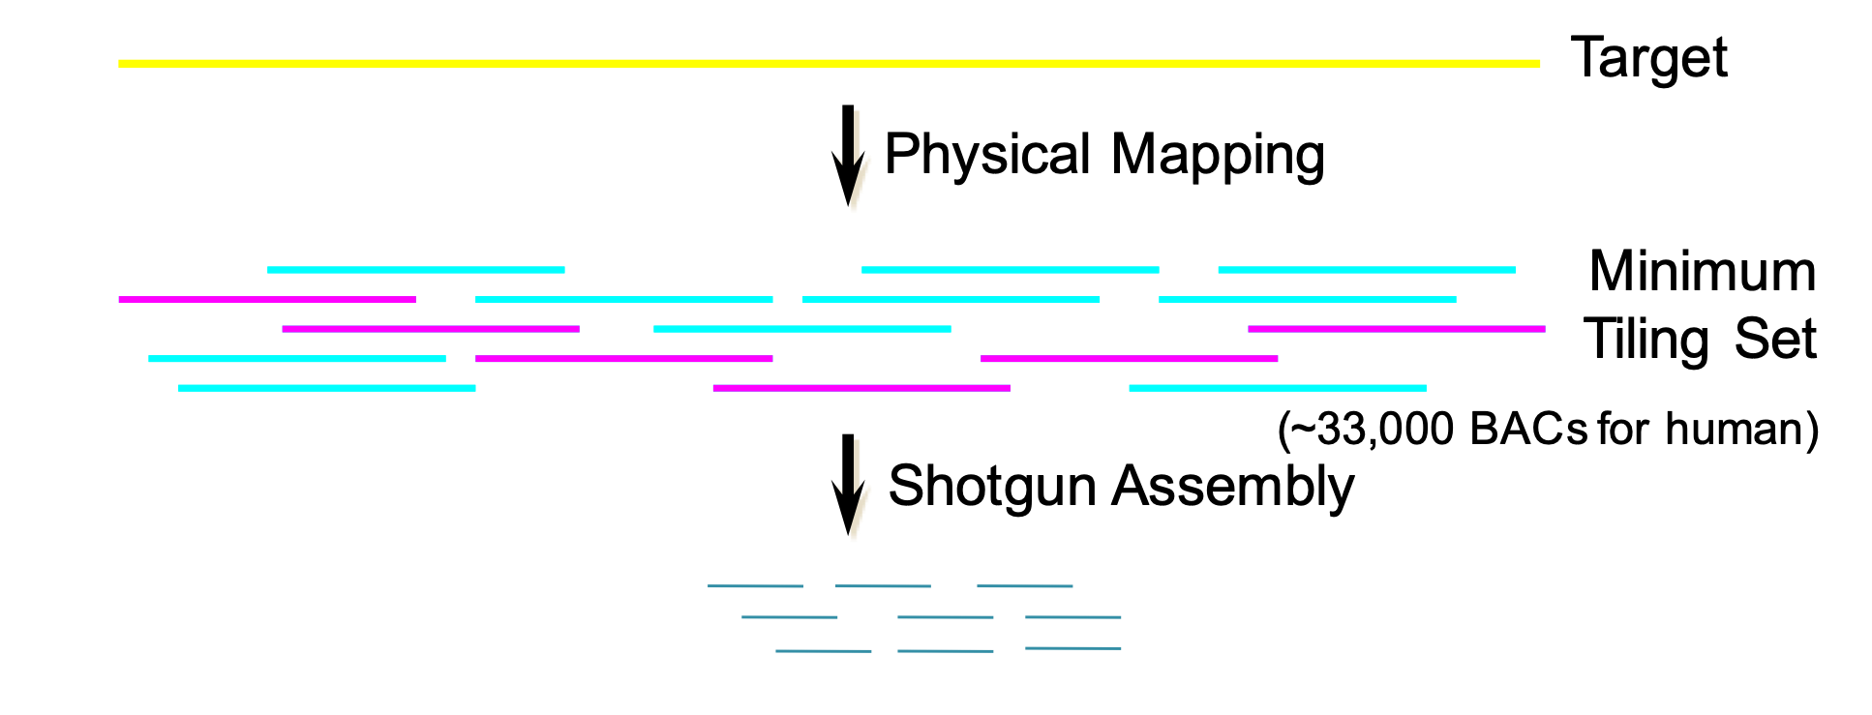
Clone-by-Clone Sequencing

Slide 7
Clone-by-Clone Sequencing
– Took ~11 years (1990-2001) to sequence 1 human and publish draft genome (complete genome: 2003)
$3B Budget, labs in 20 countries
– 2 Separate processes
– Clone libraries unstable, maps hard to complete
– Sequencing libraries must be made for every clone
+ Assembly problem ‘easy’ and well understood

Slide 8
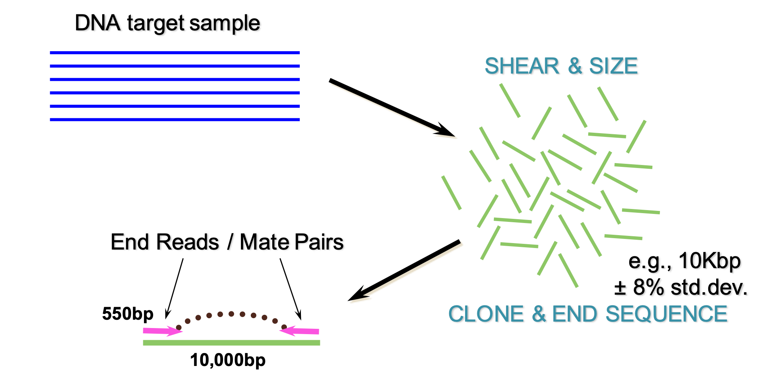
Whole-genome Shotgun Sequencing

Slide 9
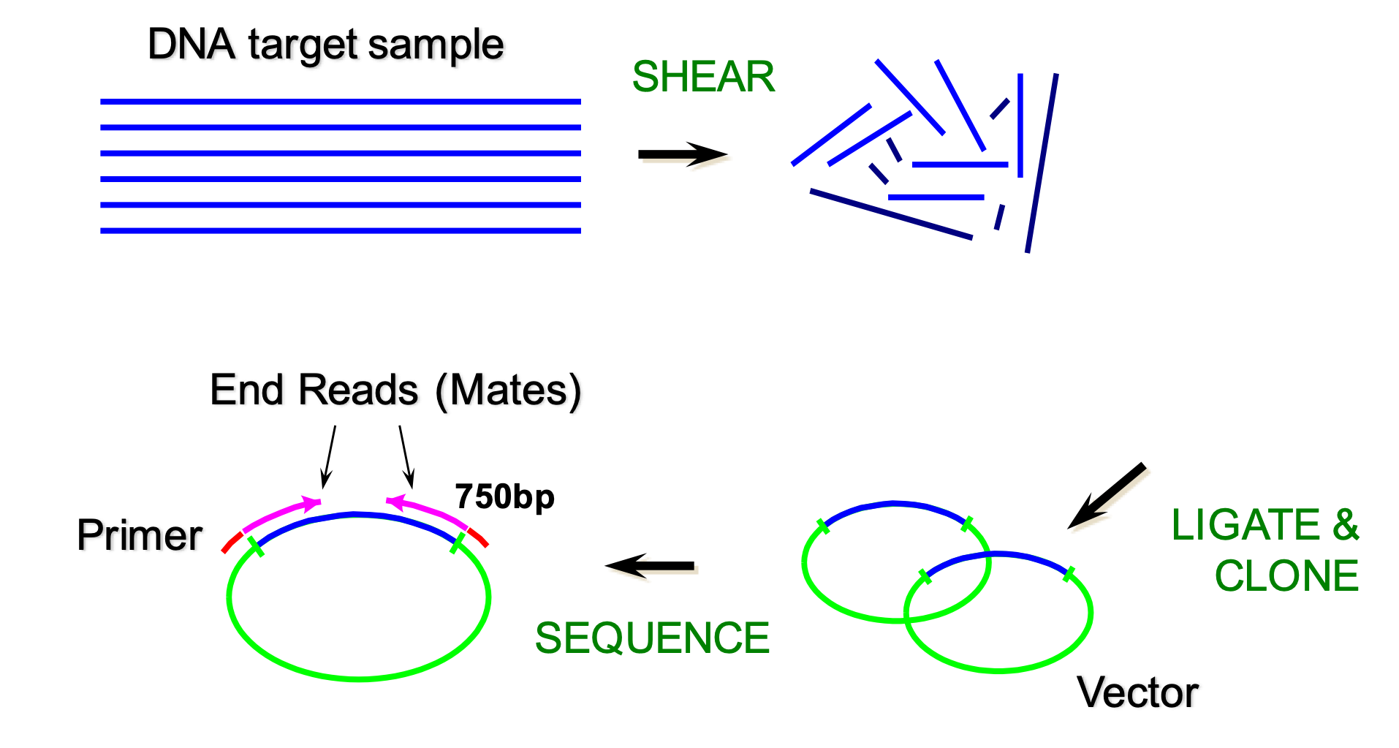
Whole-genome Shotgun Sequencing (2nd Method)

Slide 10
Whole-genome Shotgun Sequencing
+ Took ~3 years to sequence 1 human
$300M budget, labs by one company!
– Assembly problem ‘challenging’

Slide 11
Human Genome Project

Slide 12
Sanger Sequencing Assemblers
GigAssembler (International Human Genome Project, Kent & Haussler)
TIGR Assembler (TIGR)
Phrap (Univ. of Washington)
WGS (Celera)
Arachne (Batzouglou, Broad Institute)
Phusion (Mullikin et. al.)
Atlas (Havlak, Baylor College of Medicine)
CAP3, PCAP (Iowa State Univ.)
AMOS (Univ. of Maryland)
RePS (Wang et. al.)
Euler (Pevzner, Univ. of California)
gsAssembler (Roche, 454 Life Science)
DNA Baser (Cubic Design)
Elvira
SHARCGS (Genome Res., 2007)
SAKE (Bioinformatics, 2007)
SHRAP (PlusONE 2007)
New Euler (Genome Res. 2007)
Sequencher
JAZZ (Aparicio et. al)

Slide 13
Algorithmic View
Given some strings s1,s2, …, sn
We want to find the shortest string S such that all s1,s2, …, sn are substrings of S
The Shortest Common Superstring (SCS) of {“CAT”, “CGCC”, “CCCA”} is “CGCCCAT”
It is equal to Traveling Salesman Problem
So it is NP-Hard

Slide 14
Greedy Algorithm
Let T = set of all fragments
do {
For the pair (s,t) in T with maximum overlap do
merge(s,t)
} while there are at least two strings in T
Output the only string in T
This algorithm is 2.75 times optimal
It ignores the biological problems of: orientation, read errors, insertions and deletions
It is used in TIGR Assembler, Phrap and CAP3 and is the base of some other assemblers

Slide 15
Hamiltonian Path/Cycle
Wikipedia

Slide 16
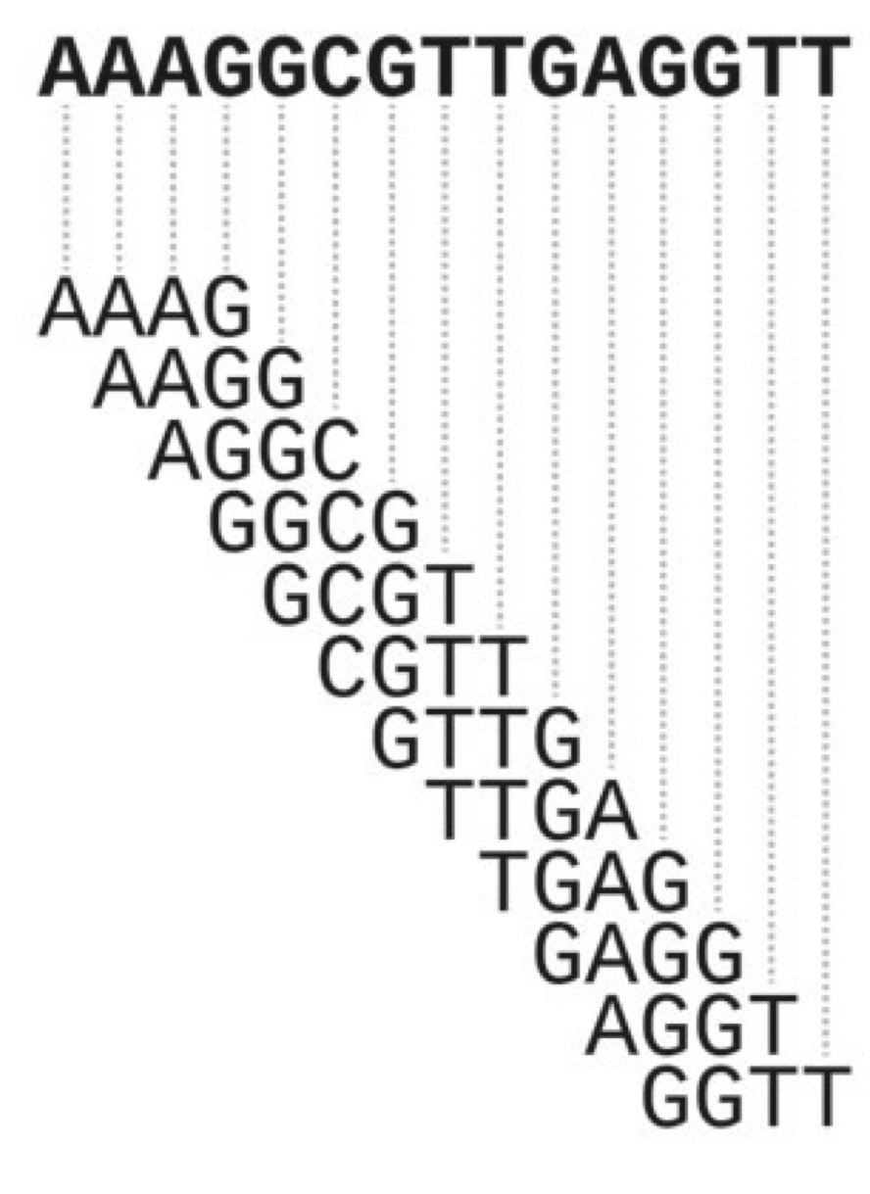
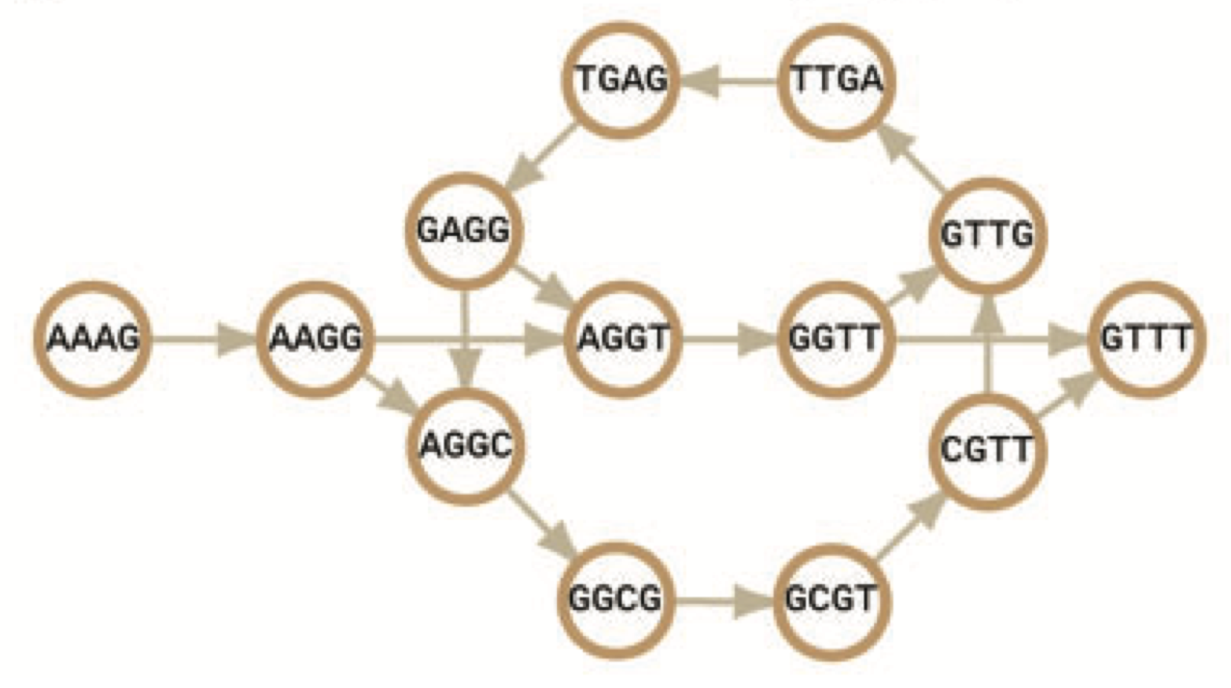
Hamiltonian Path
Jang-il Sohn and Jin-Wu Nam, Briefings in Bioinformatics, 2016

Slide 17
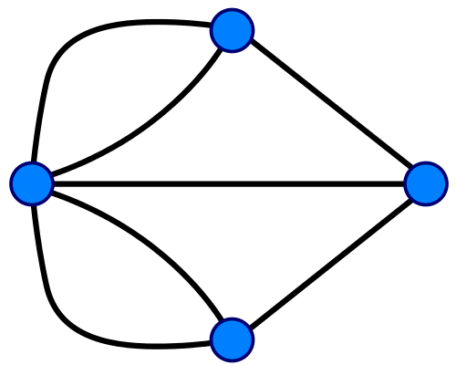
Eulerian Tour
Wikipedia

Slide 18
De Bruijn Graph
Wikipedia

Slide 19
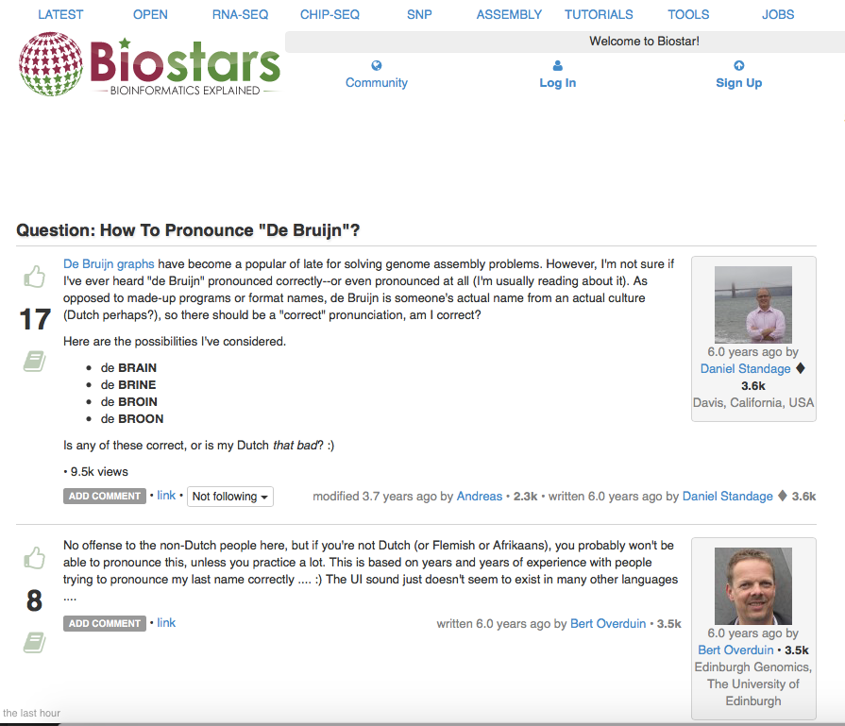

Slide 20
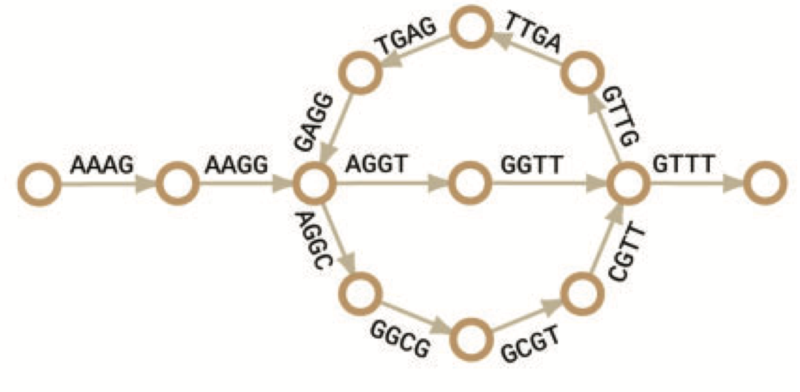
Euclidean Tour on
De Bruijn Graph
TGA
GAG
TTG
AAA
AAG
AGG
GGT
GTT
TTT
GGC
CGT
GCG
Jang-il Sohn and Jin-Wu Nam, Briefings in Bioinformatics, 2016

Slide 21
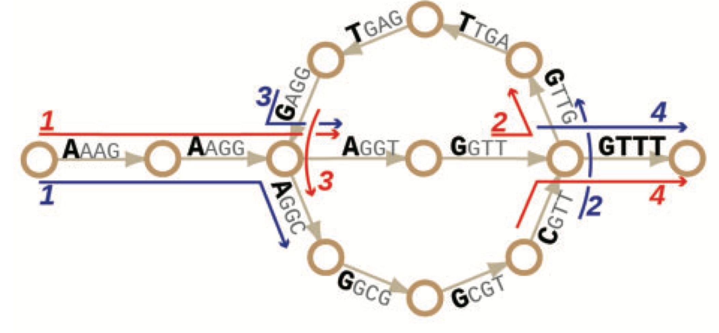
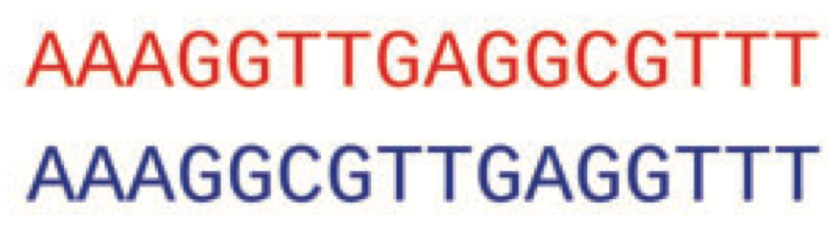
The Repeats Challenge
Jang-il Sohn and Jin-Wu Nam, Briefings in Bioinformatics, 2016

Slide 22
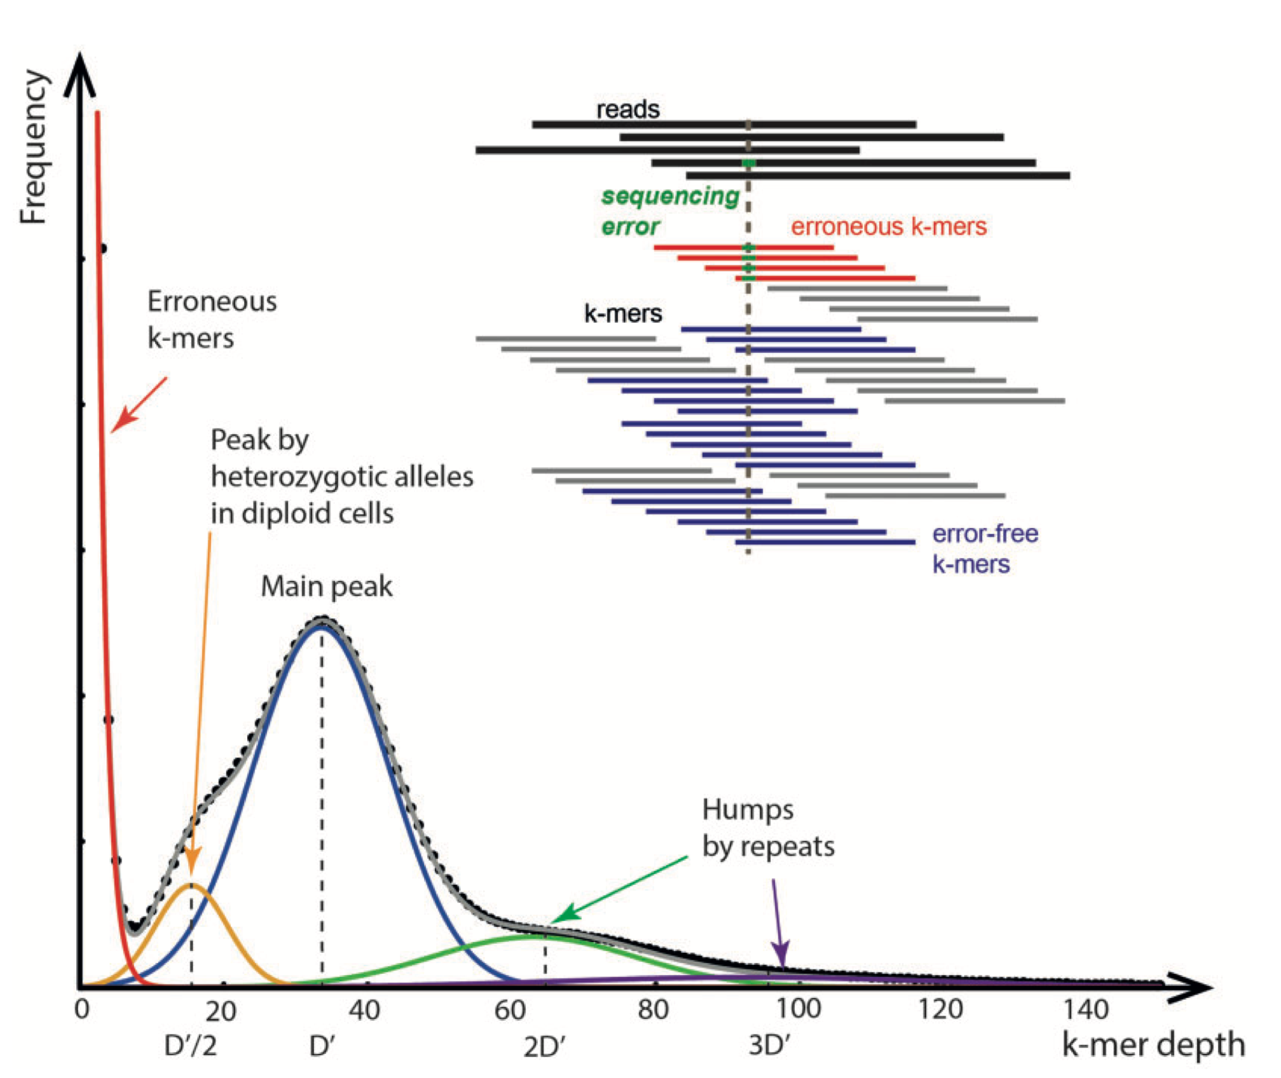
k-mer Histogram
Jang-il Sohn and Jin-Wu Nam, Briefings in Bioinformatics, 2016

Slide 23
General Assembly Procedure
The basic principle: two overlapping reads presumably originate from the same region of the genome
For the repetitive parts of the genome, this assumption is invalid!
Based on sequence similarity between reads, assembler coombines all sequencing reads into contiguous sequences, or “Contigs”
Rarely the entire chromosomes are reconstructed into a single contig
So a finishing step is performed

Slide 24
Basic Principle
Two overlapping reads presumably originate from the same genomic region
✔
𐄂
For the repeat elements, this principle is false!

Slide 25
Contigs
Based on sequence overlaps between reads, assembler combines them into contiguous sequences, or Contigs
Rarely the entire chromosomes are reconstructed into a single contig
In practice there are hundreds or thousands of contigs generated

Slide 26
Finishing
The task of closing the gaps between contigs and obtaining a complete molecule is called Finishing
First, we try to make larger structures called Scaffolds

Slide 27
Gap Filling
Two types of gaps will remain:
Sequence gaps: The gaps between contigs of same scaffold. They are covered by retrieving the original clone inserts (walking)
Physical gaps: The gaps betweens scaffolds. Filling them involves large amount of manual labor and complex laboratory techniques

Slide 28
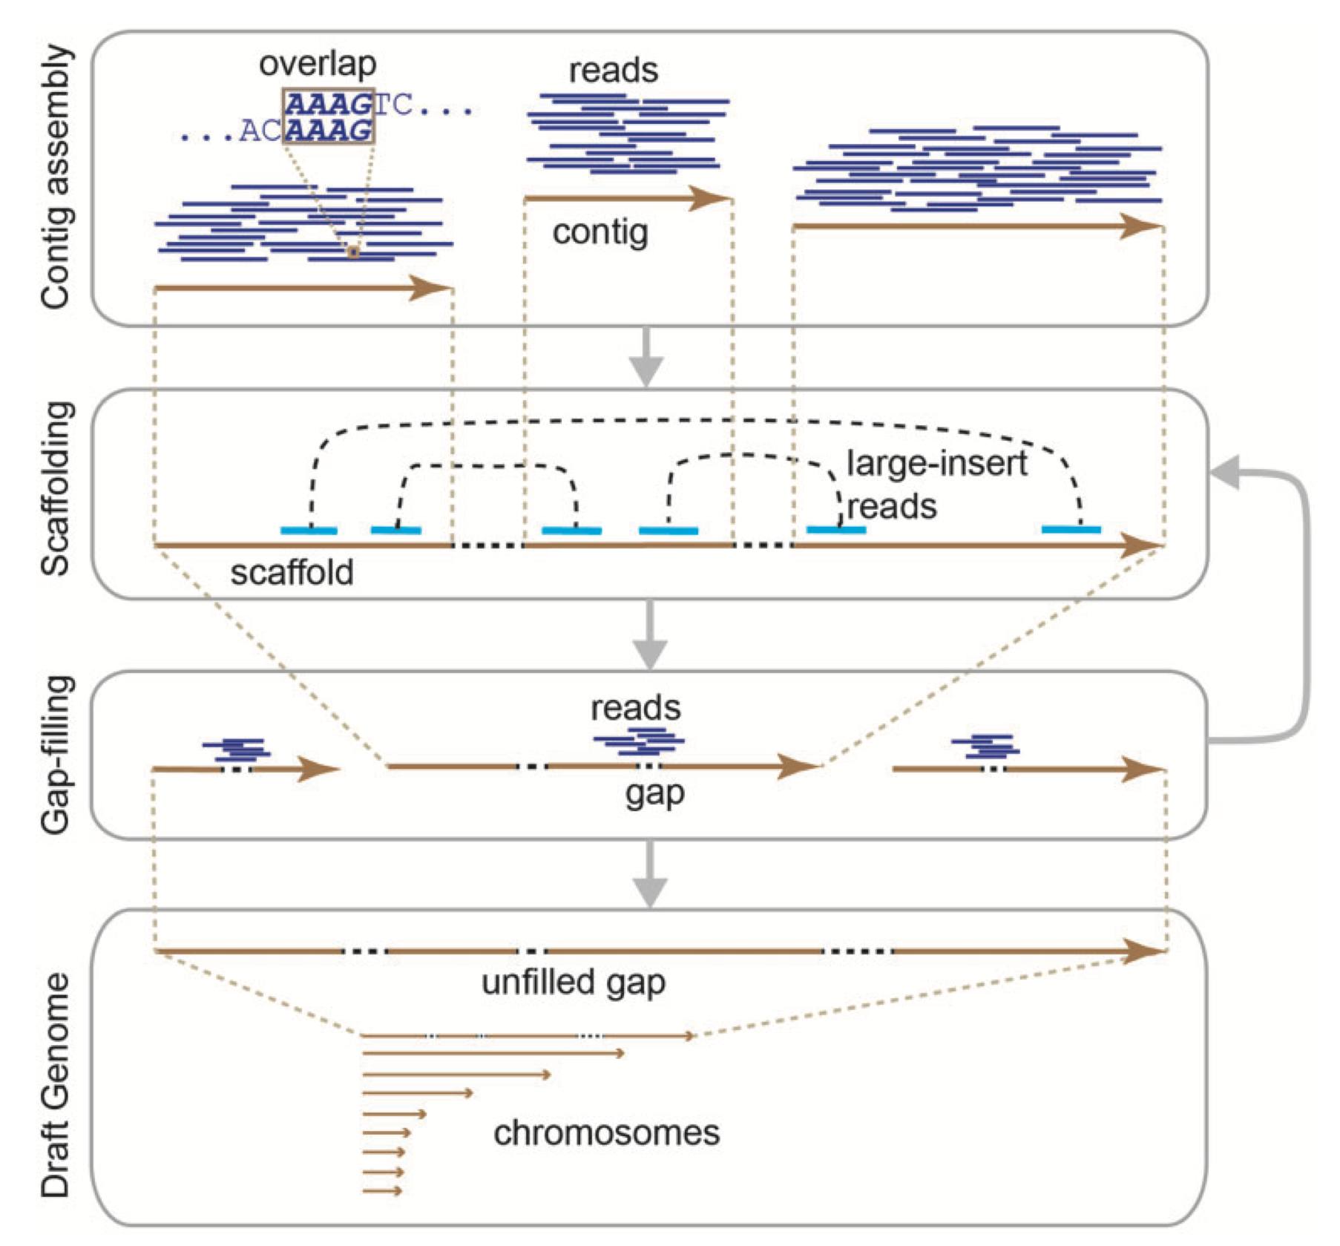
Hierarchy
Jang-il Sohn and Jin-Wu Nam, Briefings in Bioinformatics, 2016

Slide 29
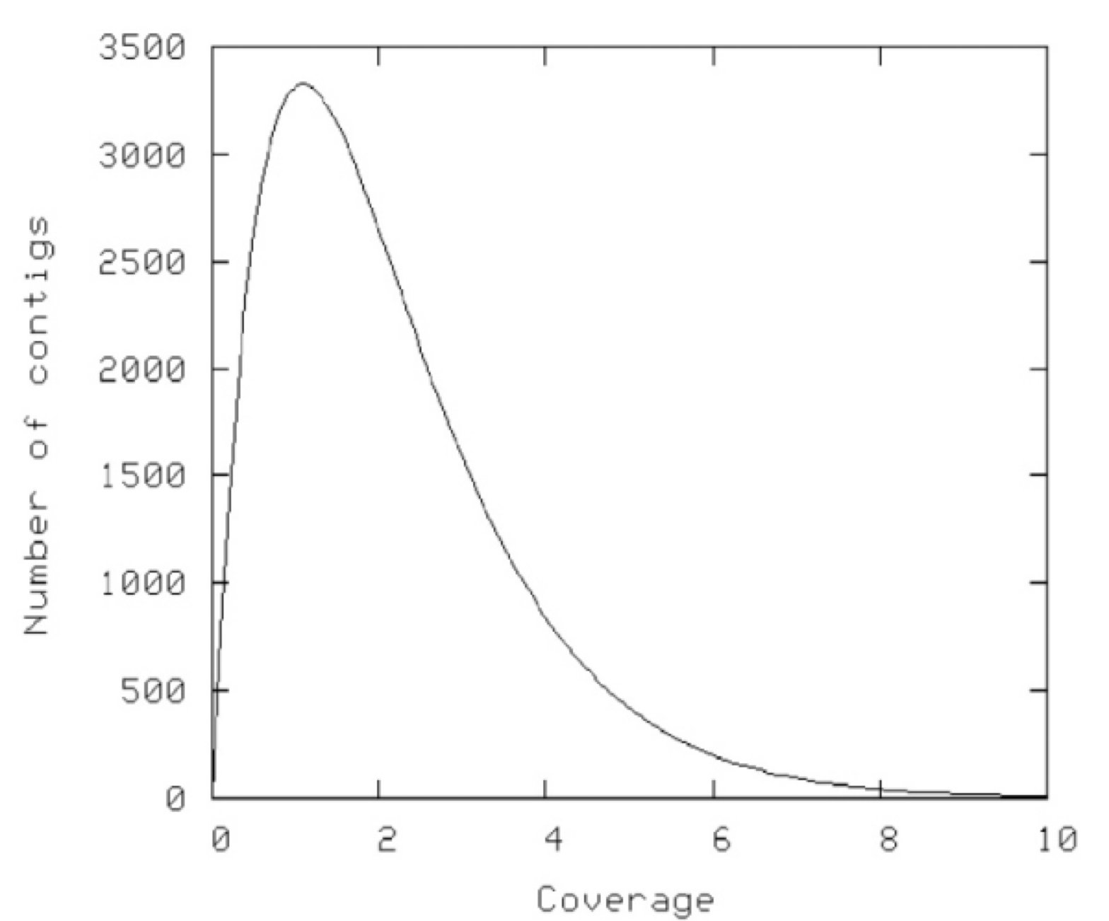
Coverage
Total size of reads / size of genome
Studied by Eric Lander and Michael Waterman in 1988:

Slide 30
Assembly Complexities
Repeats
Sequencing errors
Bias in reads
Imperfect coverage
Unknown orientation
Repeat polymorphism

Slide 31
Celera Assembler

Slide 32
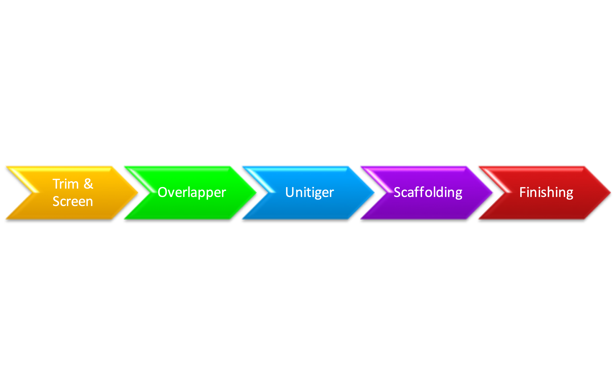
Overall procedure

Slide 33
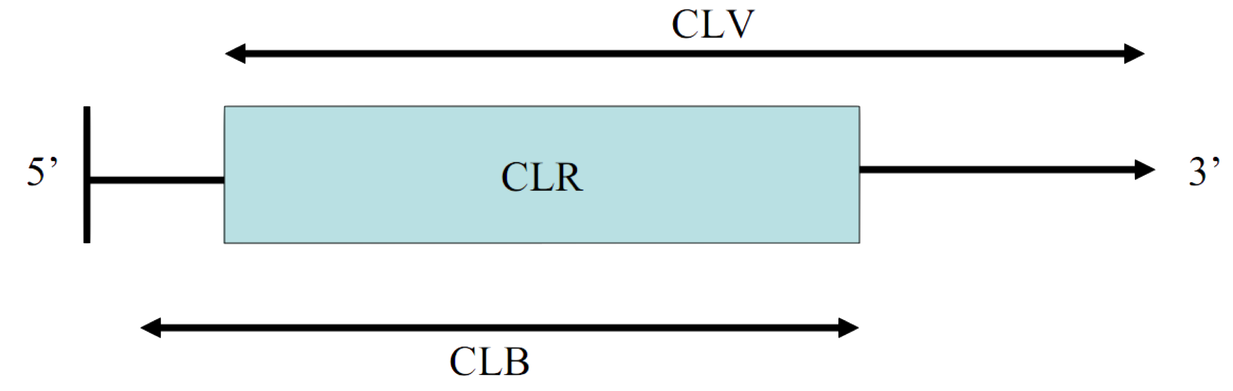
Trim & Screen
CLV: Region free of vector
CLB: Region free of bad quality reads
Trimming identifies the regions of good quality for the assembler to use (CLR), as the intersection of CLV and CLB

Slide 34
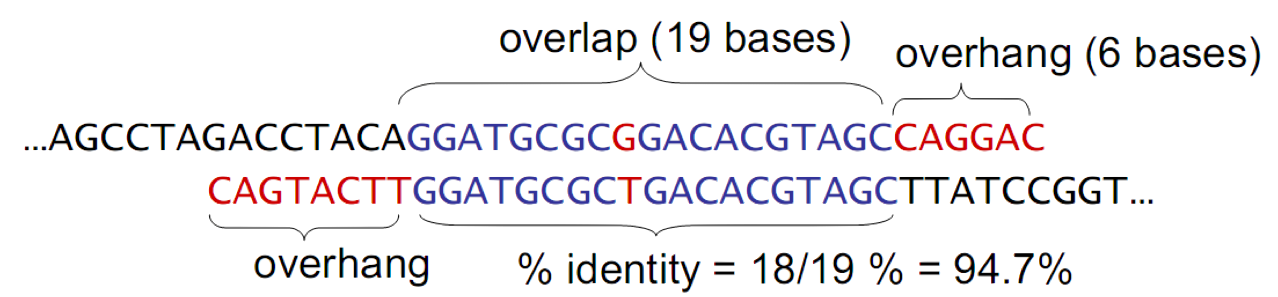
Overlapper
The assembler screens merges based on:
Length of overlap
% Identity in overlap region
Maximum overhang size

Slide 35
Overlapper
A simple solution to find all overlaps: all pairs alignment, O(n²) pairs (n=number of reads)
Better idea: O(n x coverage) algorithm
Build a table of k-mers in sequences
Generate the pairs from one pass read of the table

Slide 36
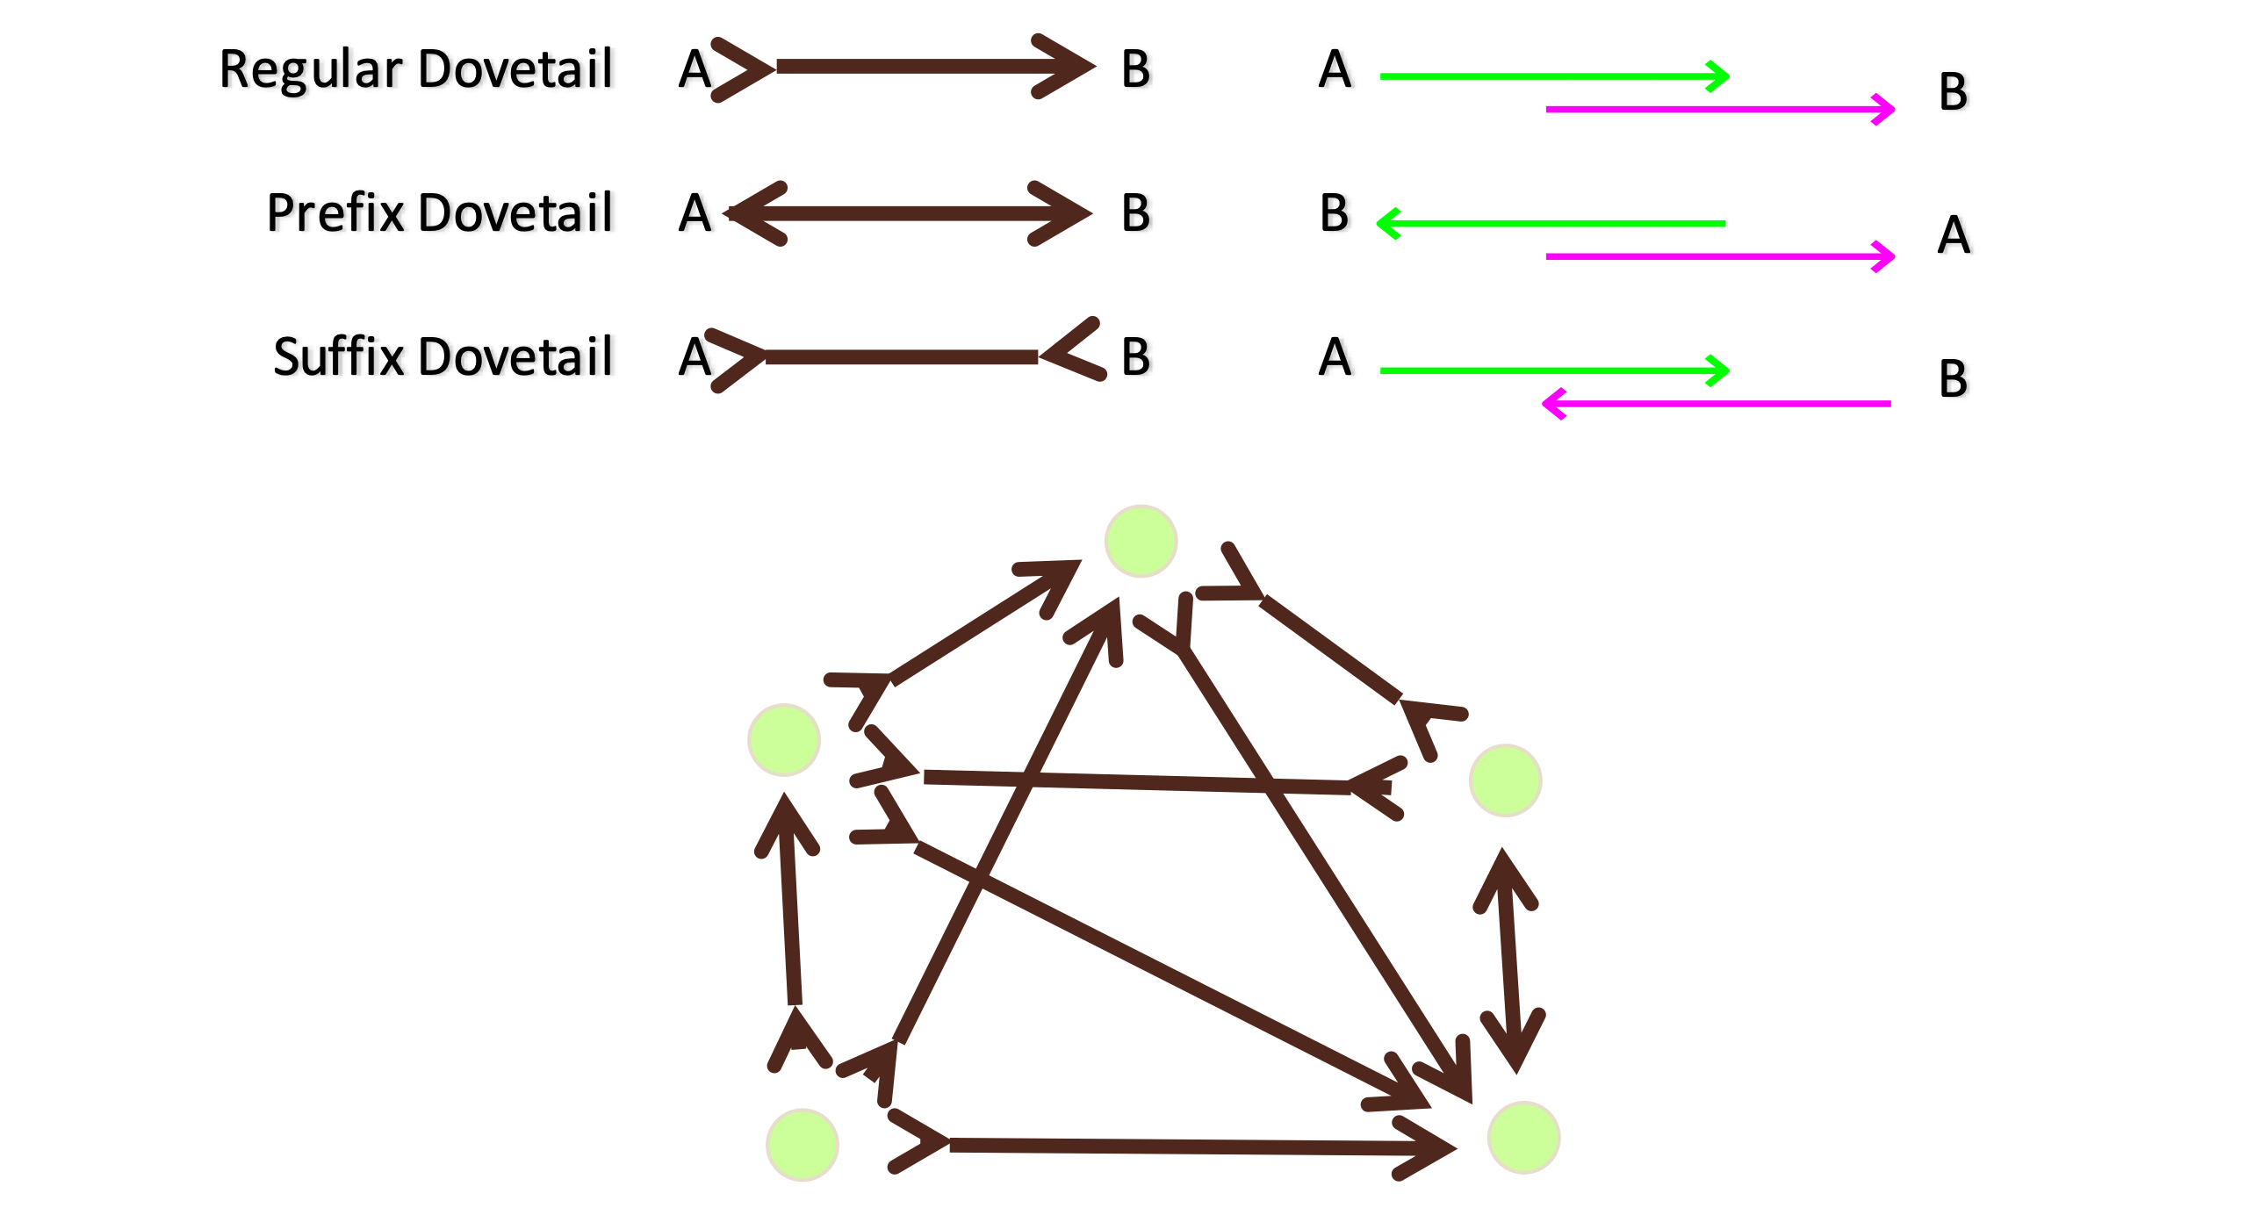
Overlap Types

Slide 37
Dovetail?

Slide 38
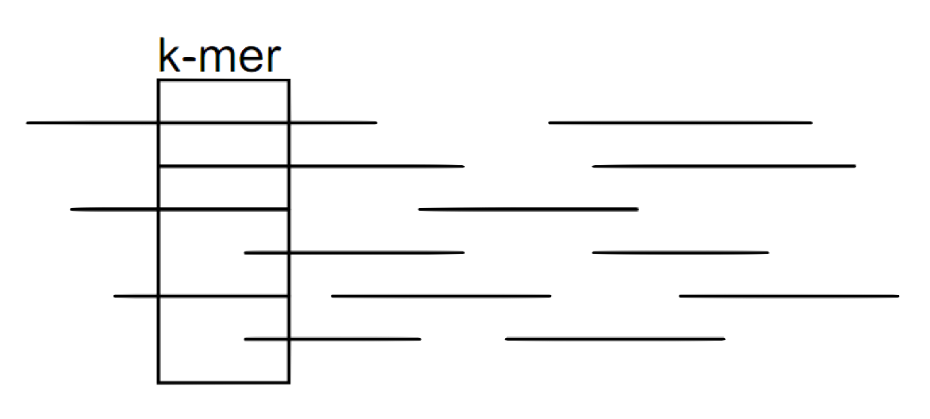
Overlapper

Slide 39
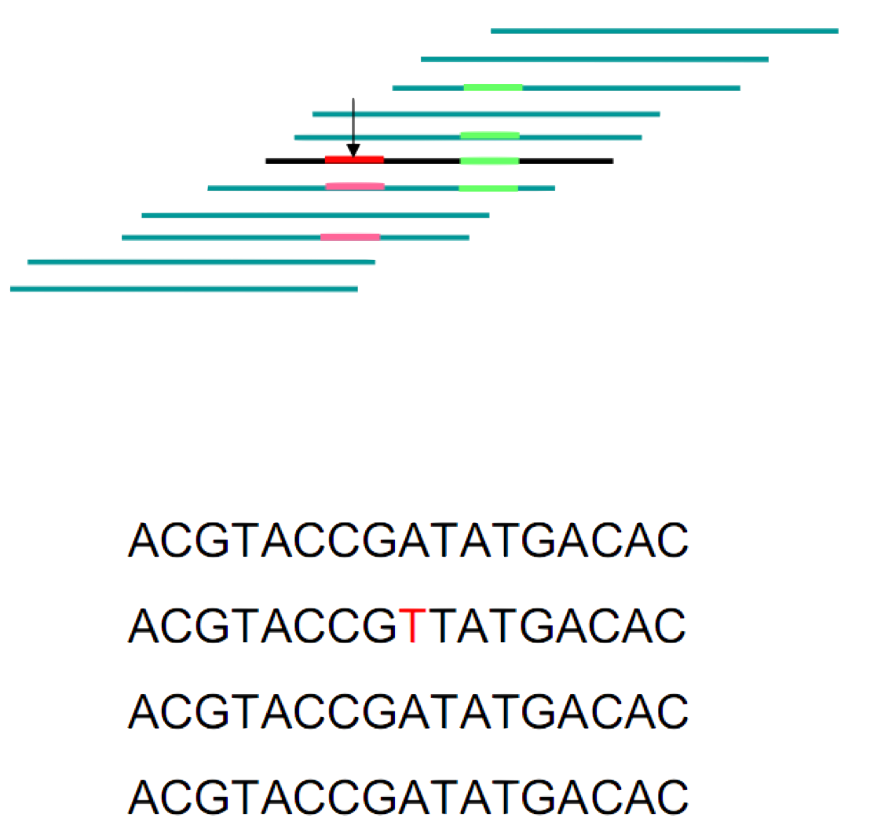
Error Correction
If the k-mers from overlapping reads match, their bases are confirmed
If a base is not confirmed, there is a vote for error correction

Slide 40
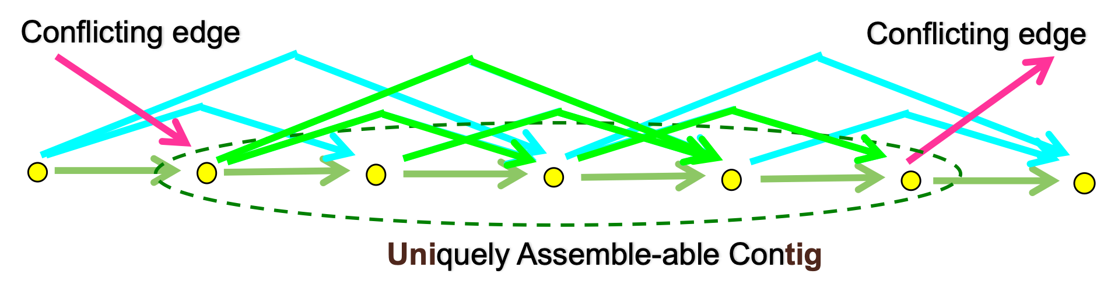
Unitiger
Compute all overlap consistent sub-assemblies
Finds Unitigs (Uniquely Assembled Contig)

Slide 41
Unitiger Algorithm
Remove contained fragments
Remove transitively inferred edges
Collapse into unitigs

Slide 42
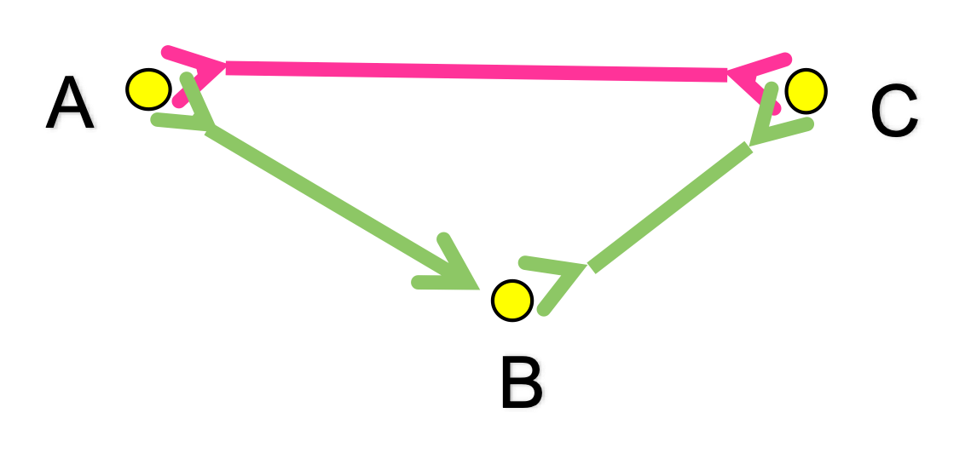
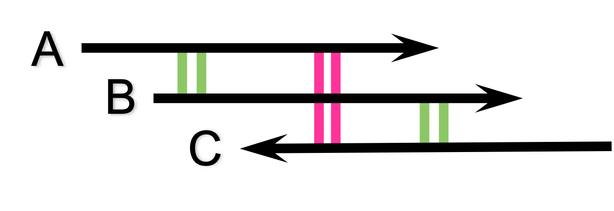
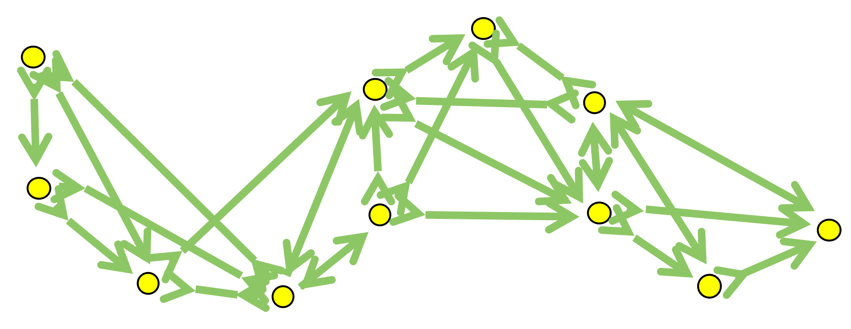
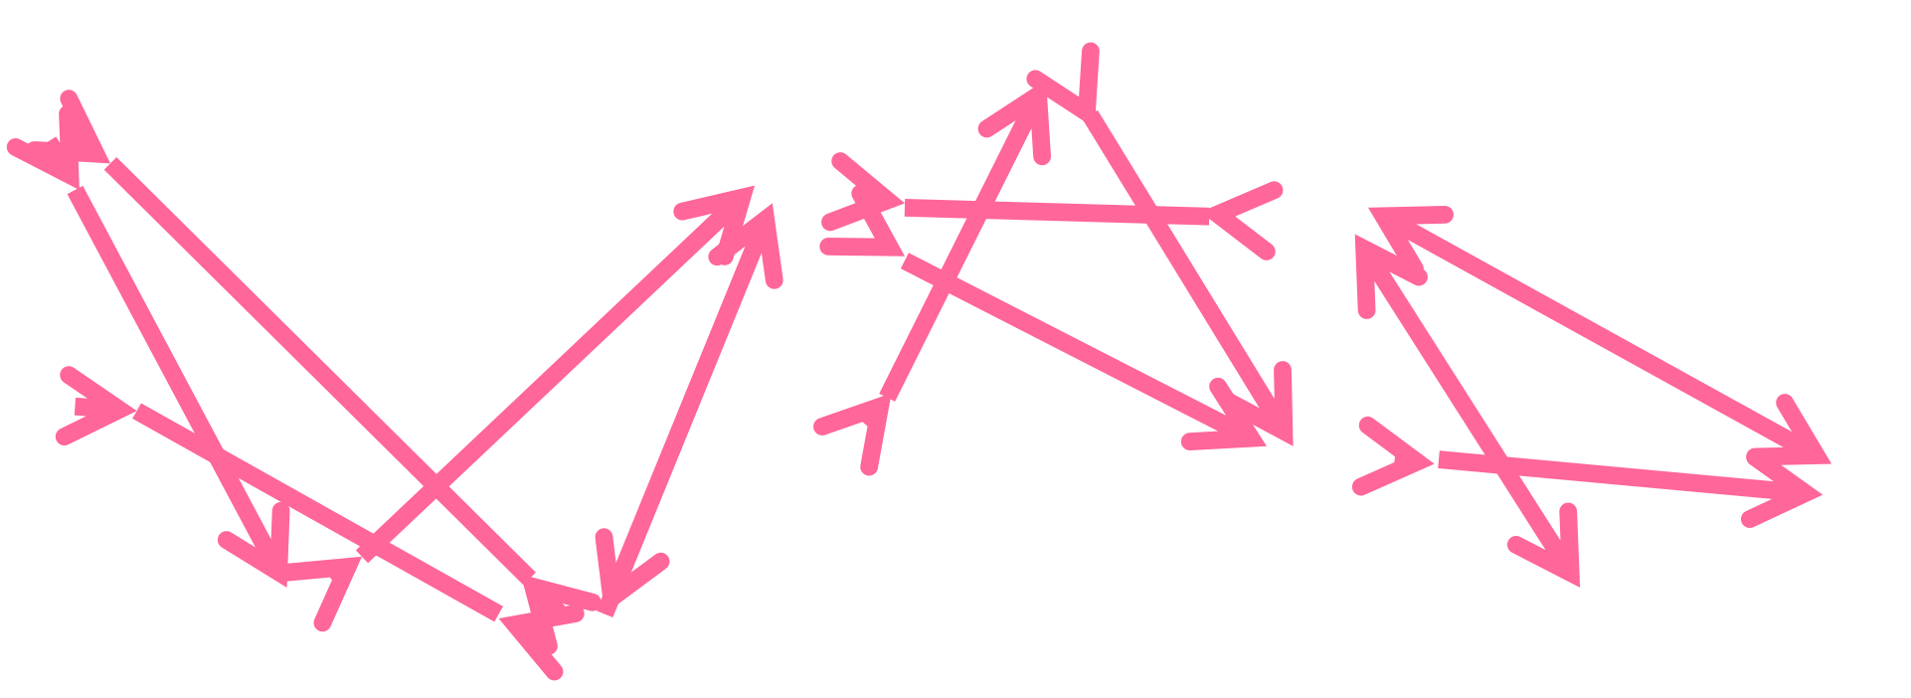
Transitive Edges Removal

Slide 43
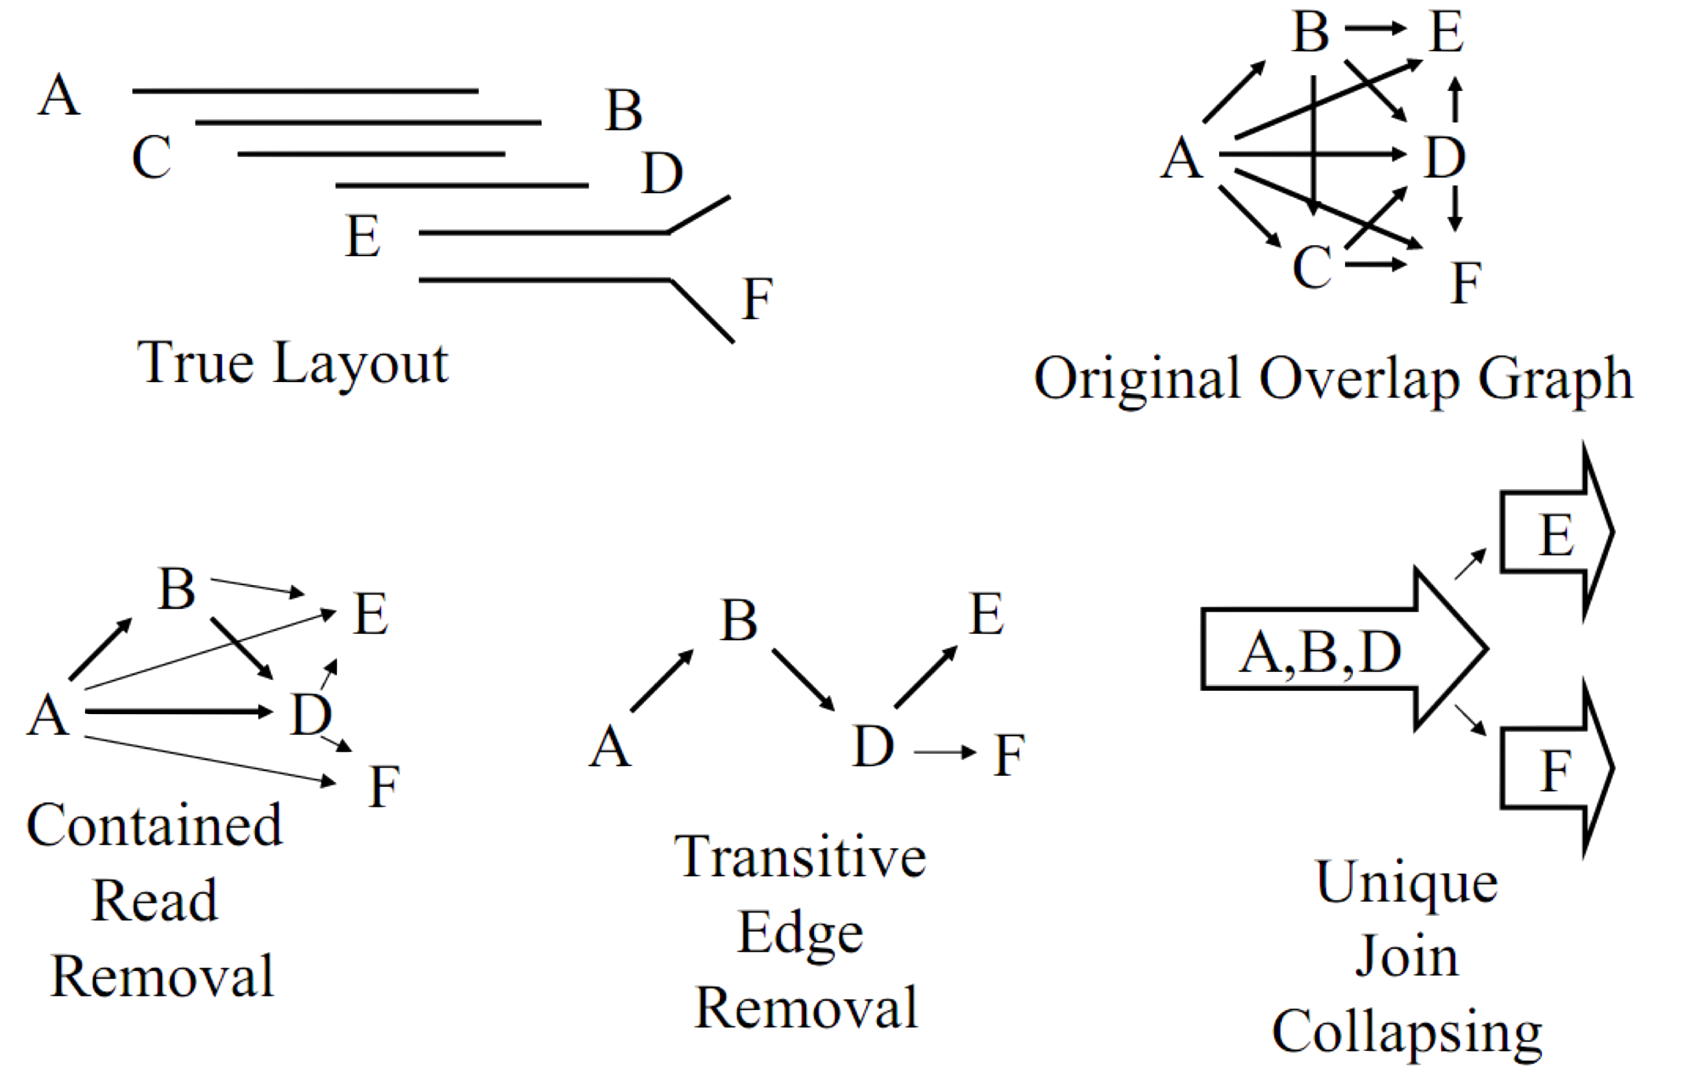
Unitiger

Slide 44
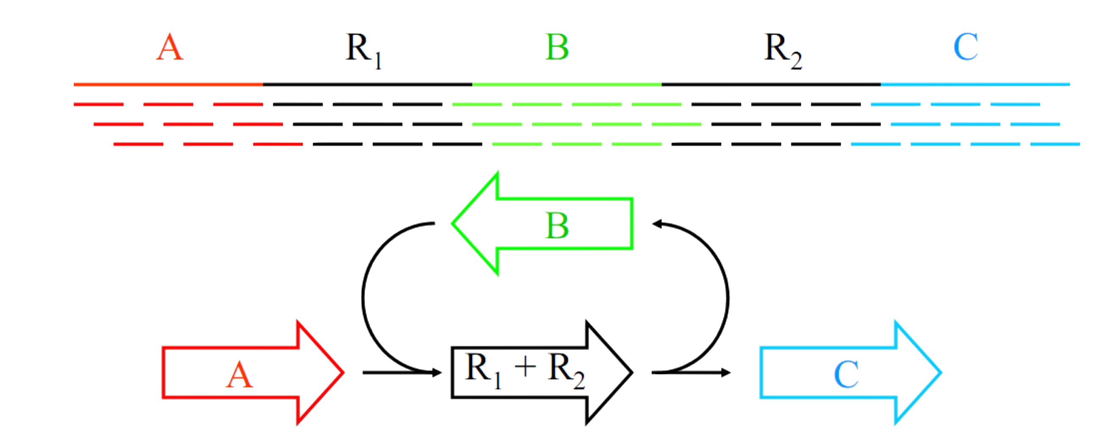
Unitig Scoring
Compute the statistical arrival rate for each unitig, considering that all reads have uniform distribution
The higher arrival rate for a unitig, the lower reliability of it

Slide 45
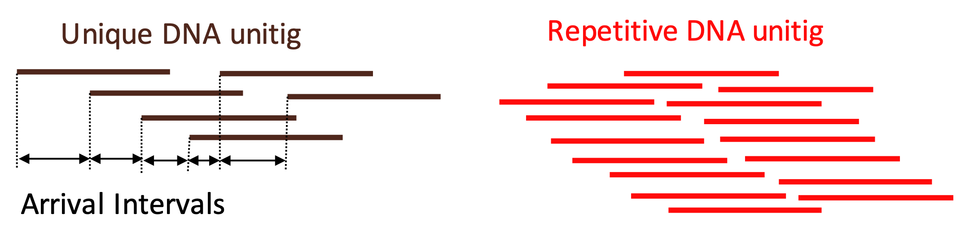
A-stat Scoring

Slide 46
A-stat Scoring
Suppose there are F fragments in a database and the genome size is estimated as G
For a unitig with k fragments and distance ρ between the start of its first fragment and the start of its last fragment, the probability of seeing the k − 1 start points in the interval of length ρ, given the unitig is not oversampled, is [(ρF/G)^{k}/k!] exp(−ρF/G).

Slide 47
A-stat Scoring
If the unitig was the result of collapsing two repeats, then the probability is [(2ρF/G)^{k}/k!]exp(−2ρF/G)

Slide 48
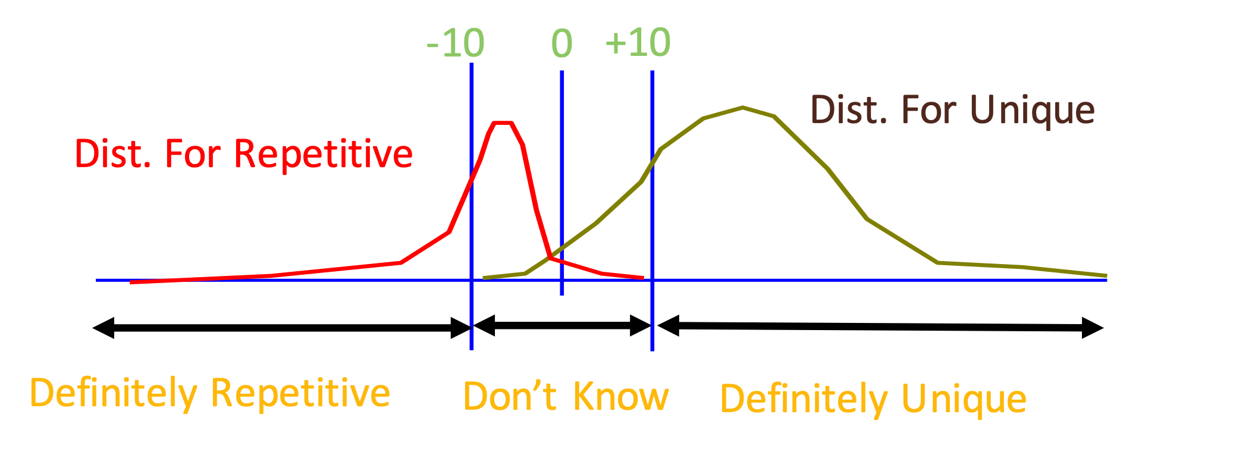
Discriminator A-statistics
Log-odds ratio of probability unitig is unique DNA versus 2-copy DNA
A-stat (unitig X) = log [ Prob (X is single-copy | coverage (X)) / Prob (X is two-copy | coverage (X)) ]

Slide 49
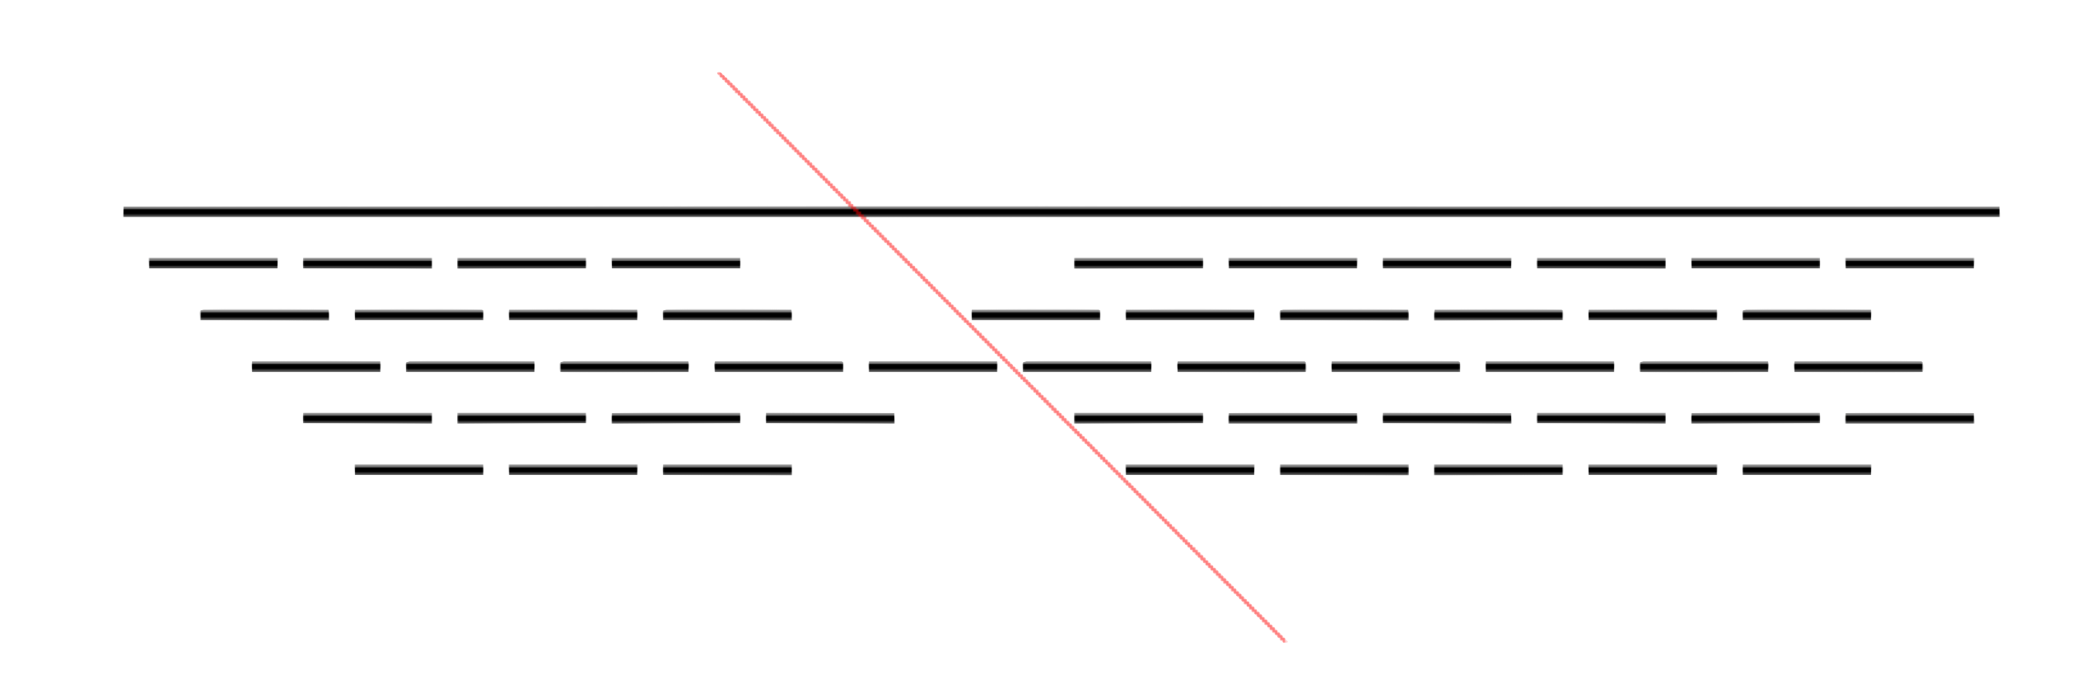
Uniting Splitting
Unitigs are split when the coverage level drops below a threshold, and there are no mates connecting the Unitig

Slide 50
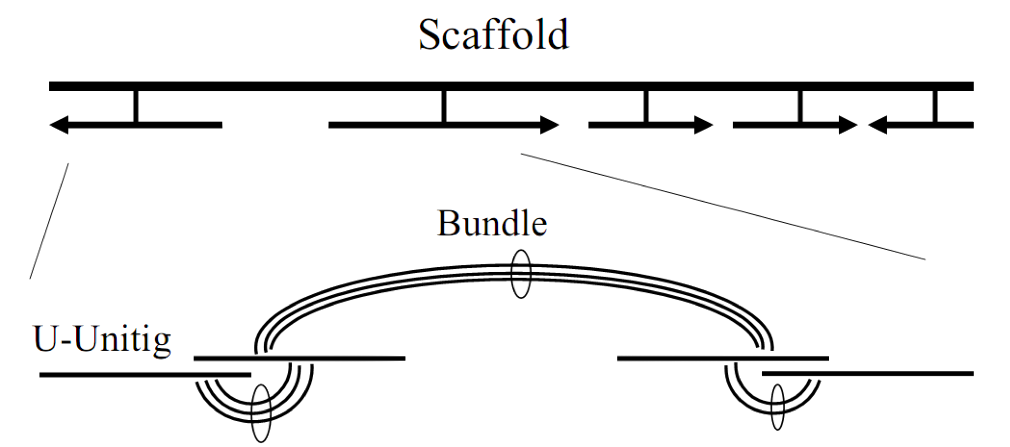
Scaffolding
Create a initial scaffold of unique unitigs (U-Unitigs) whose A-stat > 5
Crete borderline unitigs whose A-stat is > 2 having consistent mates with the U-Unitigs

Slide 51
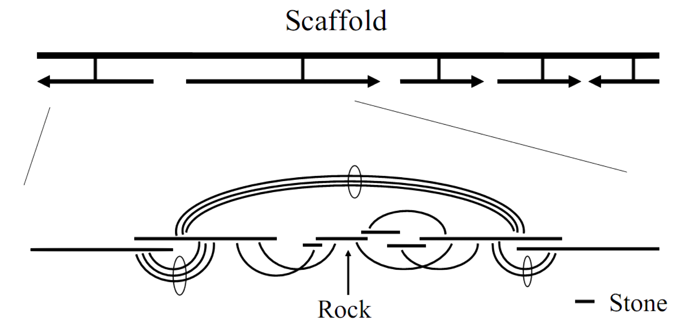
Finishing
Place rocks (A-stat > 0 with multiple consistent mates), and stones (single mate and overlap path with placed objects) into the gaps
Pebbles, unitigs lacking mates, are no longer incorporated regardless of overlap qualities

Slide 52
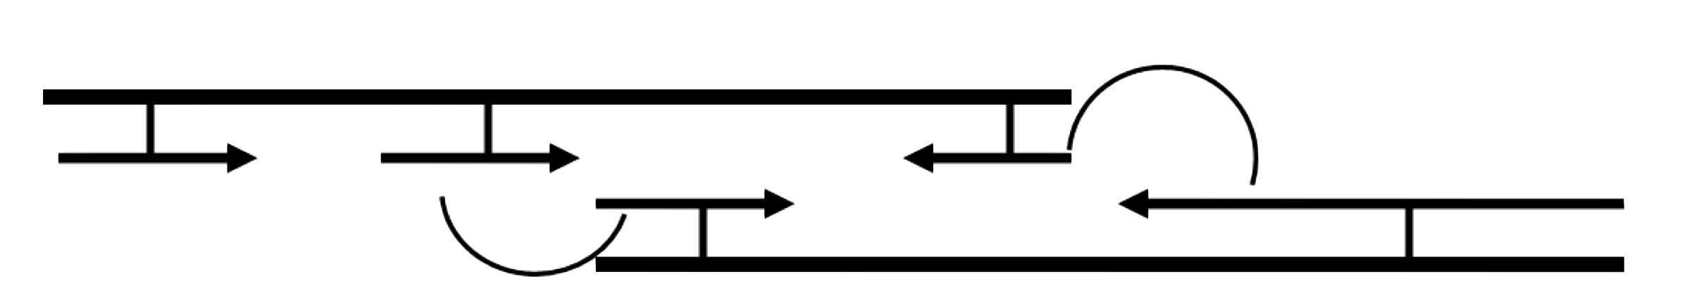
Scaffold Merging
After placing borderline unitigs and rocks, there may be sufficient mates to merge scaffolds (mates from stones are not considered)
If multiple orientations are possible, choose the scaffold merge with the happiest mates
This in turn may allow for new rocks and stones to be placed, so iterate these steps until the scaffold stabilizes

Slide 53
Celera Summary
1. Compute Overlaps between reads
2. Simplify Overlap Graph into Unitigs
3. Score Unitigs based on Coverage
4. Create Contigs & Scaffold of Unique Unitigs
5. Fill in gaps with repetitive unitigs

Slide 54
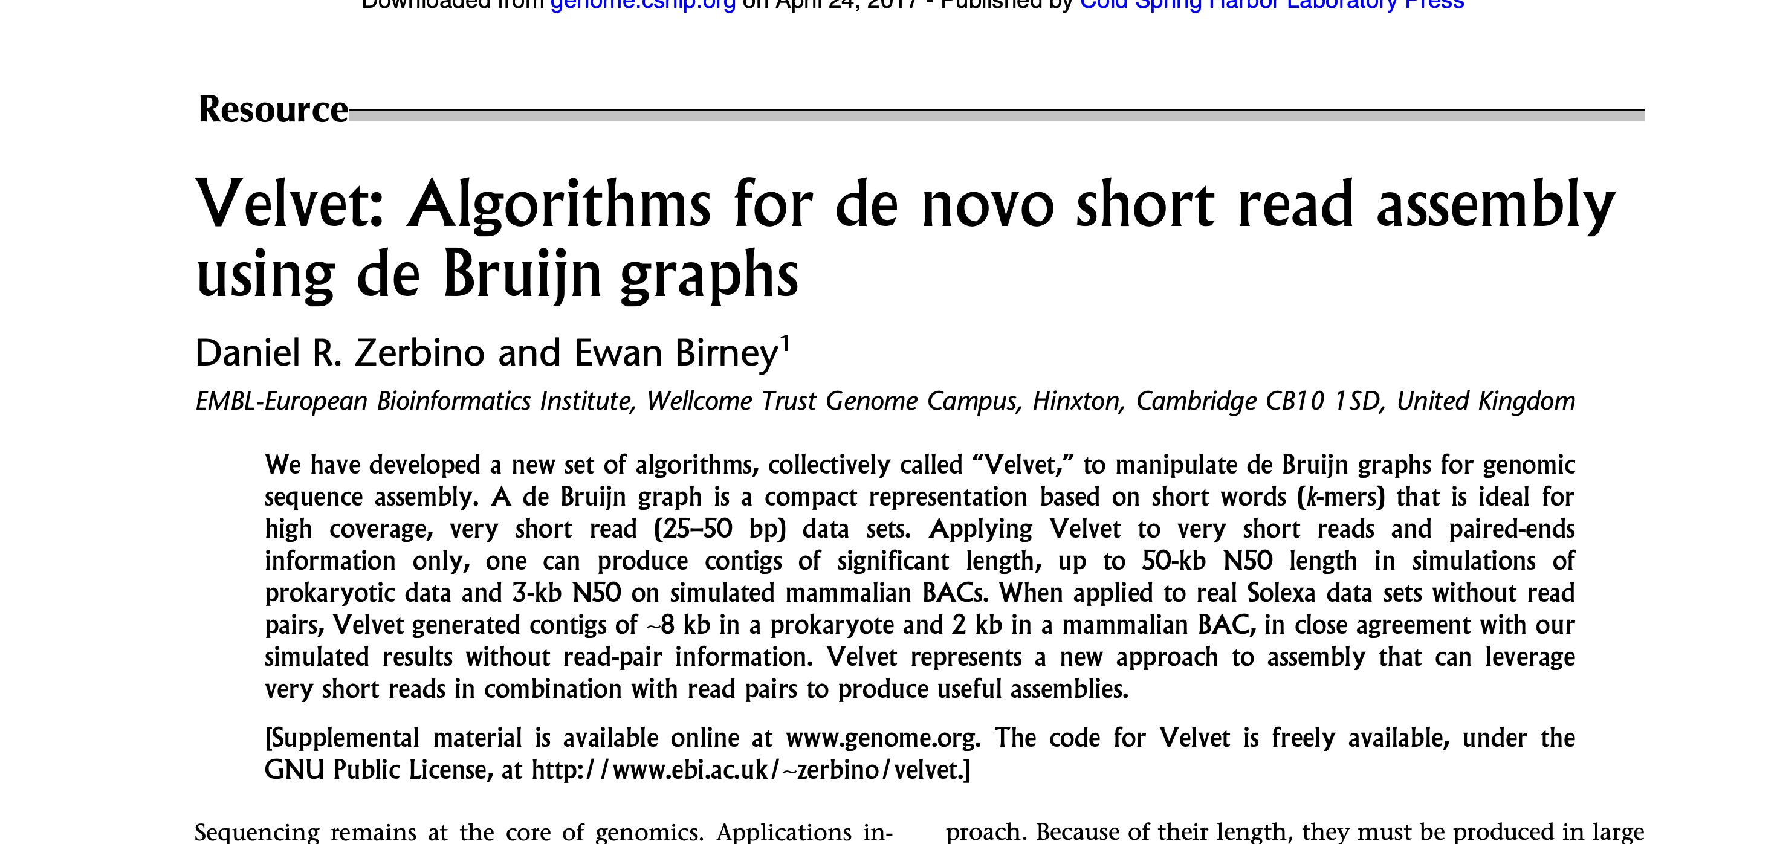

Slide 55
SPAdes

Slide 56
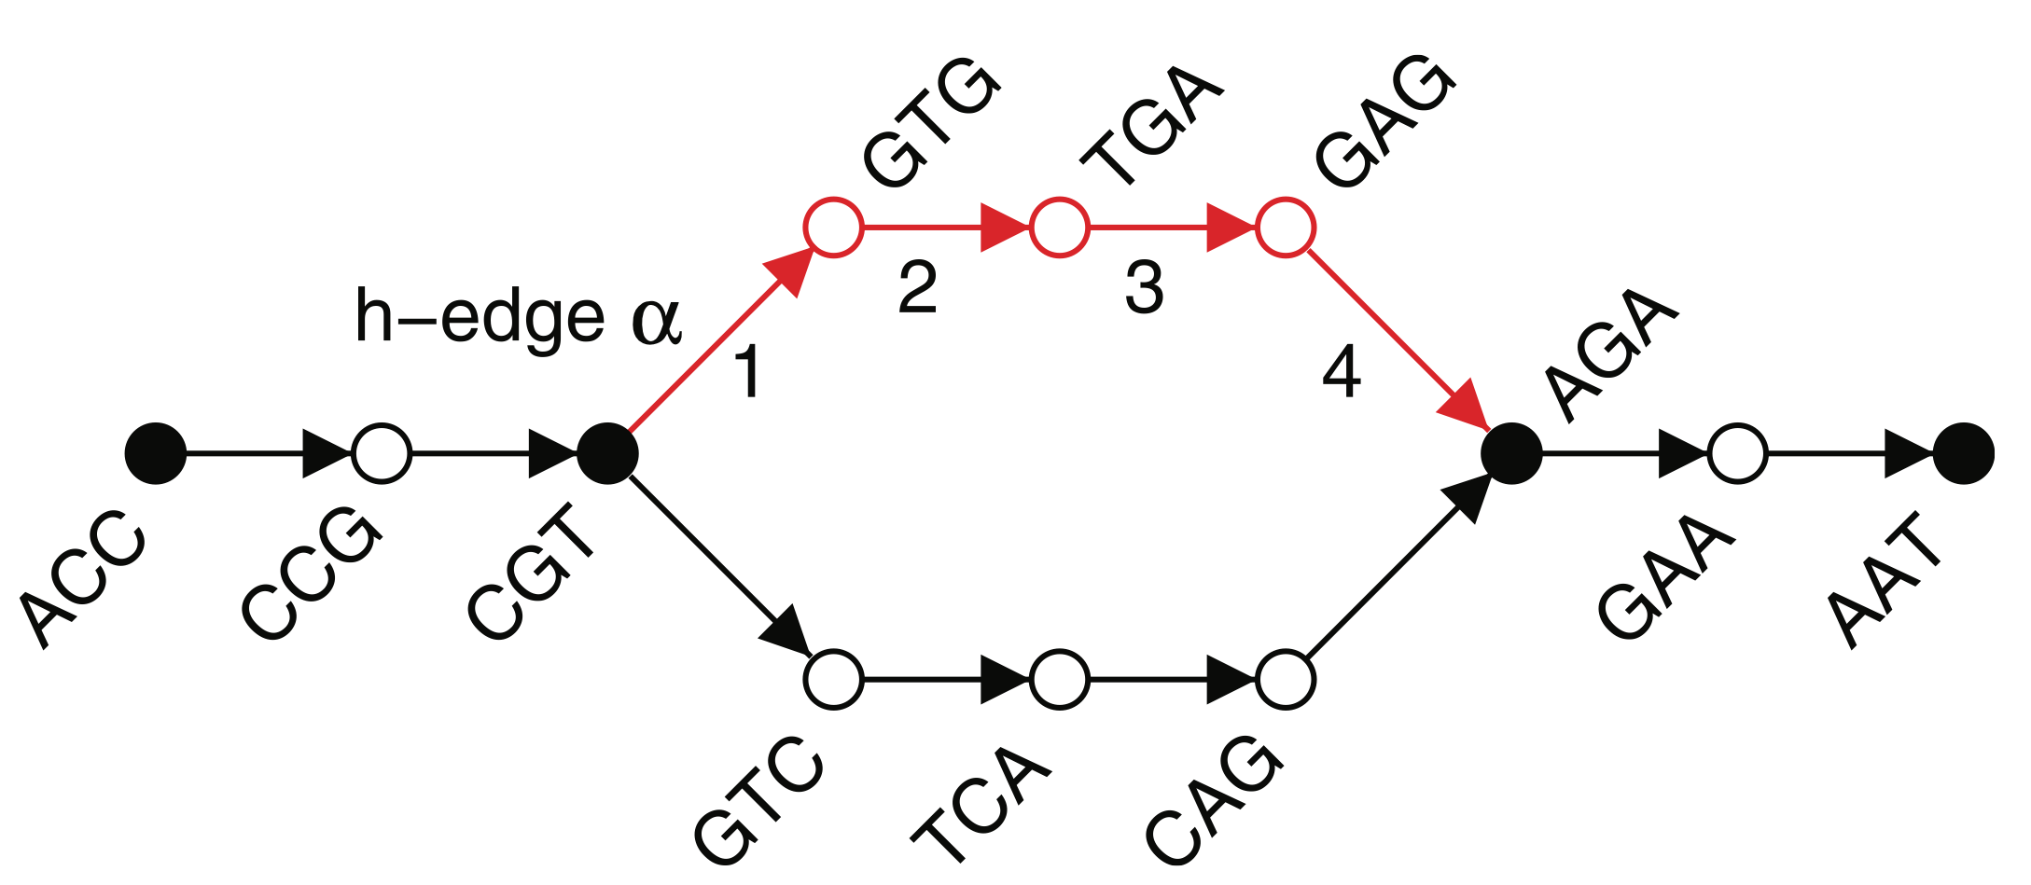
h-paths, h-reads

Slide 57
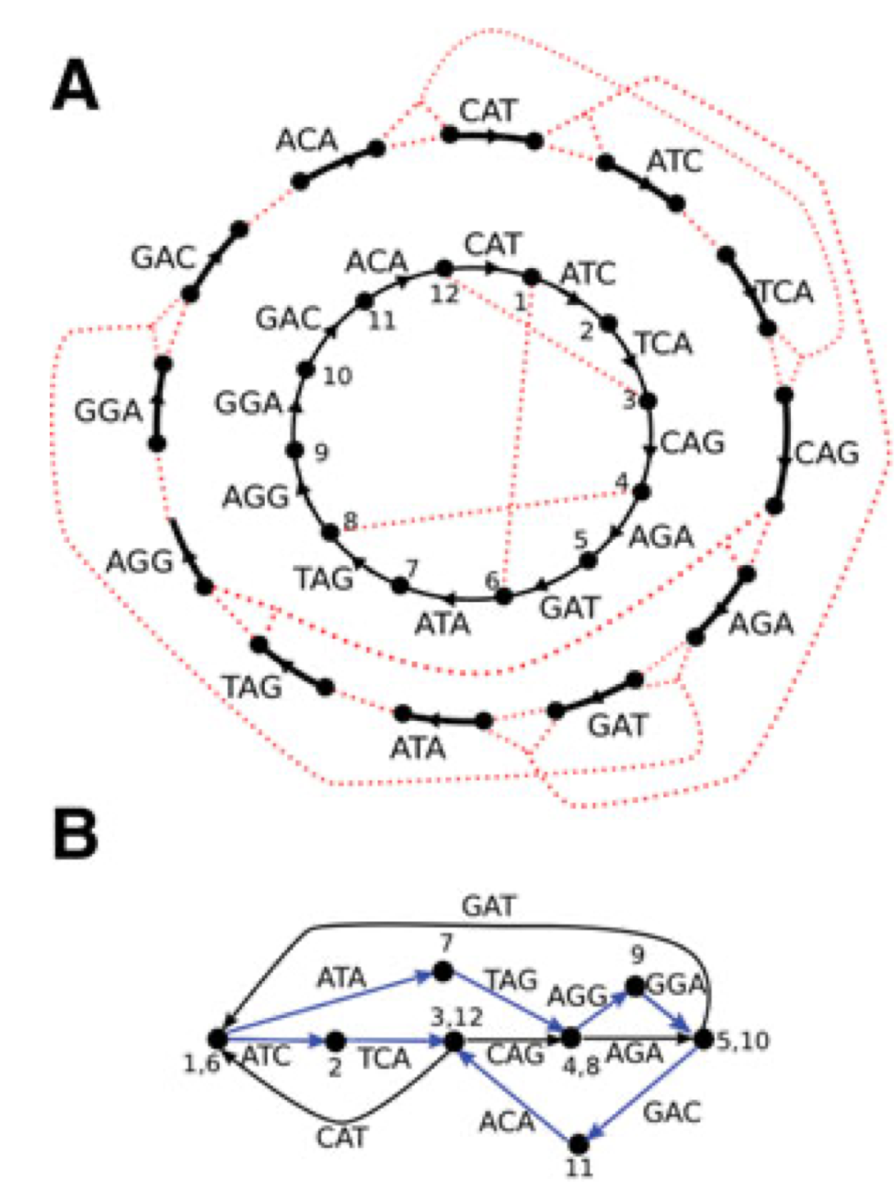
3-mers Graph

Slide 58
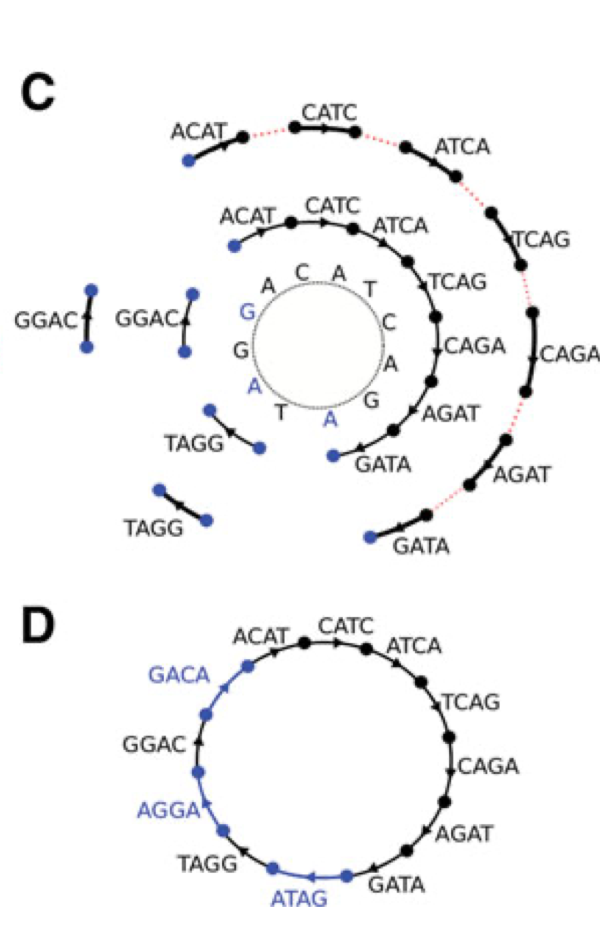
3,4-mers Graph

